Slide 1
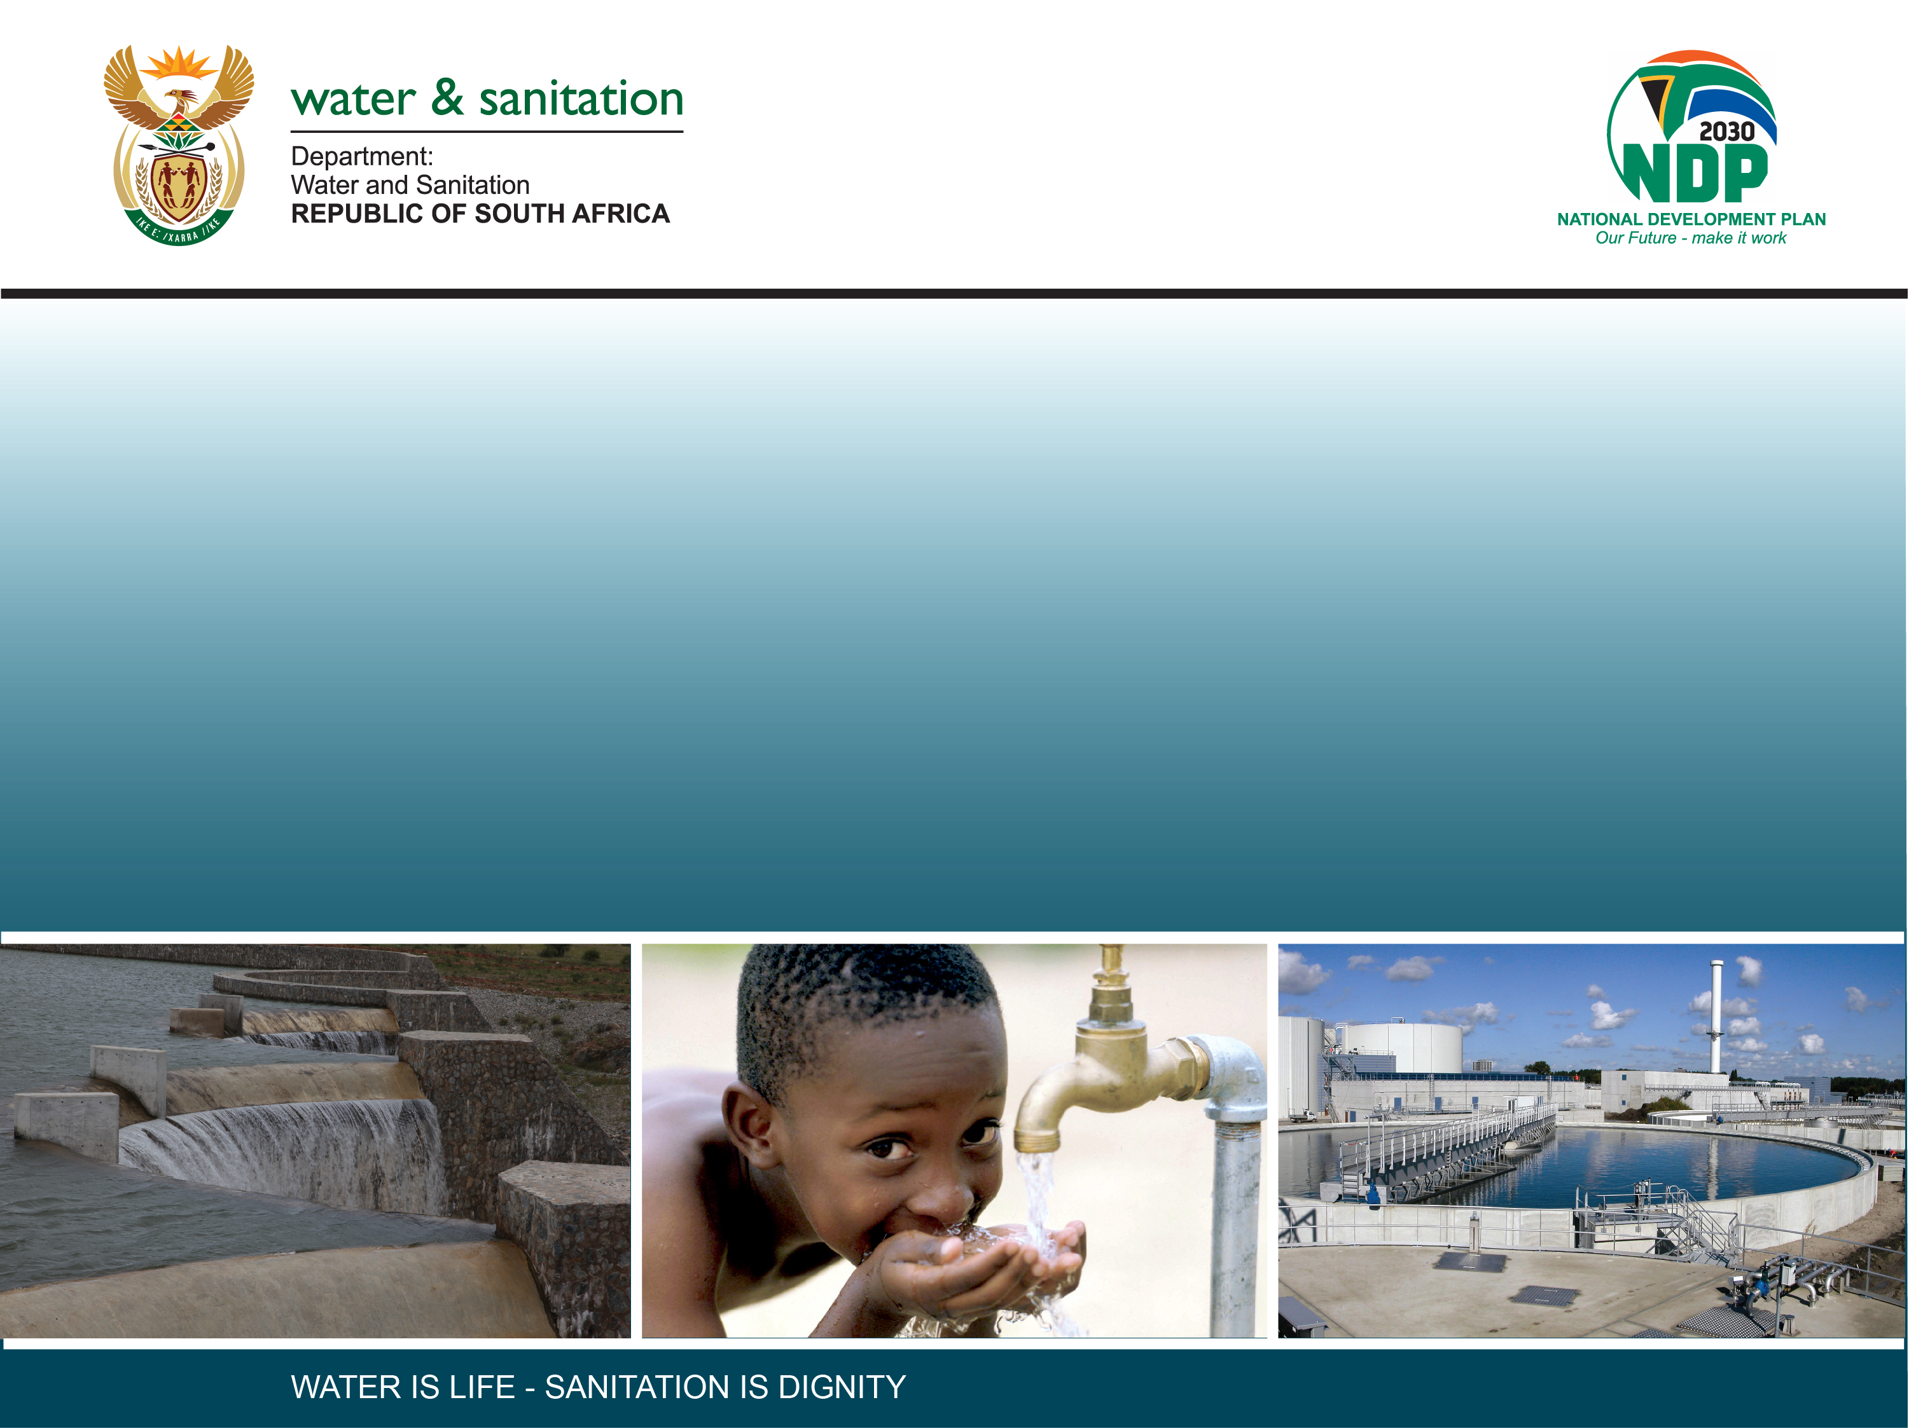
A HIGH CONFIDENCE RESERVE DETERMINATION STUDY FOR SURFACE WATER, GROUNDWATER AND WETLANDS IN THE UPPER ORANGE CATCHMENT (WP11343)
PROJECT STEERING COMMITTEE MEETING 1
30 June 2022

Slide 2
Presentation
Background to Project
  Study Area
Study objective and approach
Gaps analysis
Resource Units
Field surveys
Next steps…

Slide 3
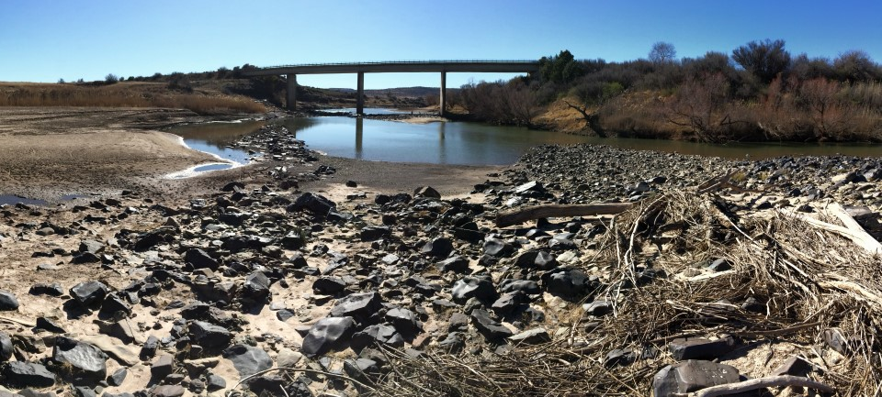
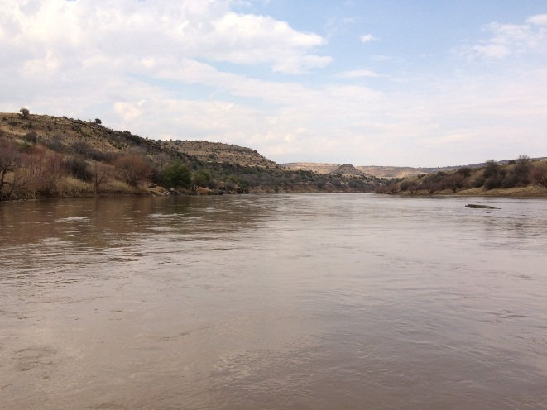
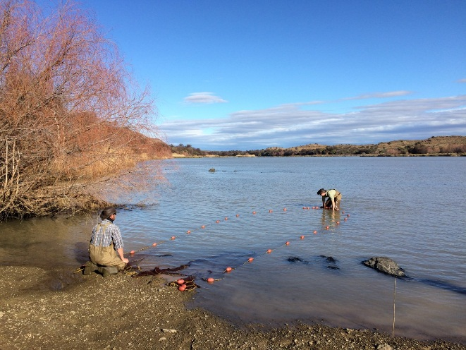
Background to Project
Upper Orange System is a working catchment under increasing stress from a water quality/quantity perspective.
The Department needs to ensure that the water supply remains sufficient to meet the requirements of both current and future users.
  A high confidence Reserve determination for the rivers, wetlands and groundwater in the Upper Orange Catchment
  Guide the Department to:
      Meet the objectives of maintaining/improving the state of the water resources within this catchment.
      Process water use license applications

Slide 4
Study area: Rivers
Rivers:
Catchment divided into four distinct sub-areas:
Caledon River from its headwaters and tributaries to the Gariep Dam;
The Orange River from the Lesotho Border to the Gariep Dam, including the main tributaries Kornetspruit, Sterkspruit, Stormbergespruit
The Kraai River catchment; and
The Orange River from the Gariep Dam, through Vanderfkloof Dam to Marksdrift weir, including the Seekoei River in the south, and the Modder-Riet River (main tributaries of the Vaal River system) in the north.

Slide 5
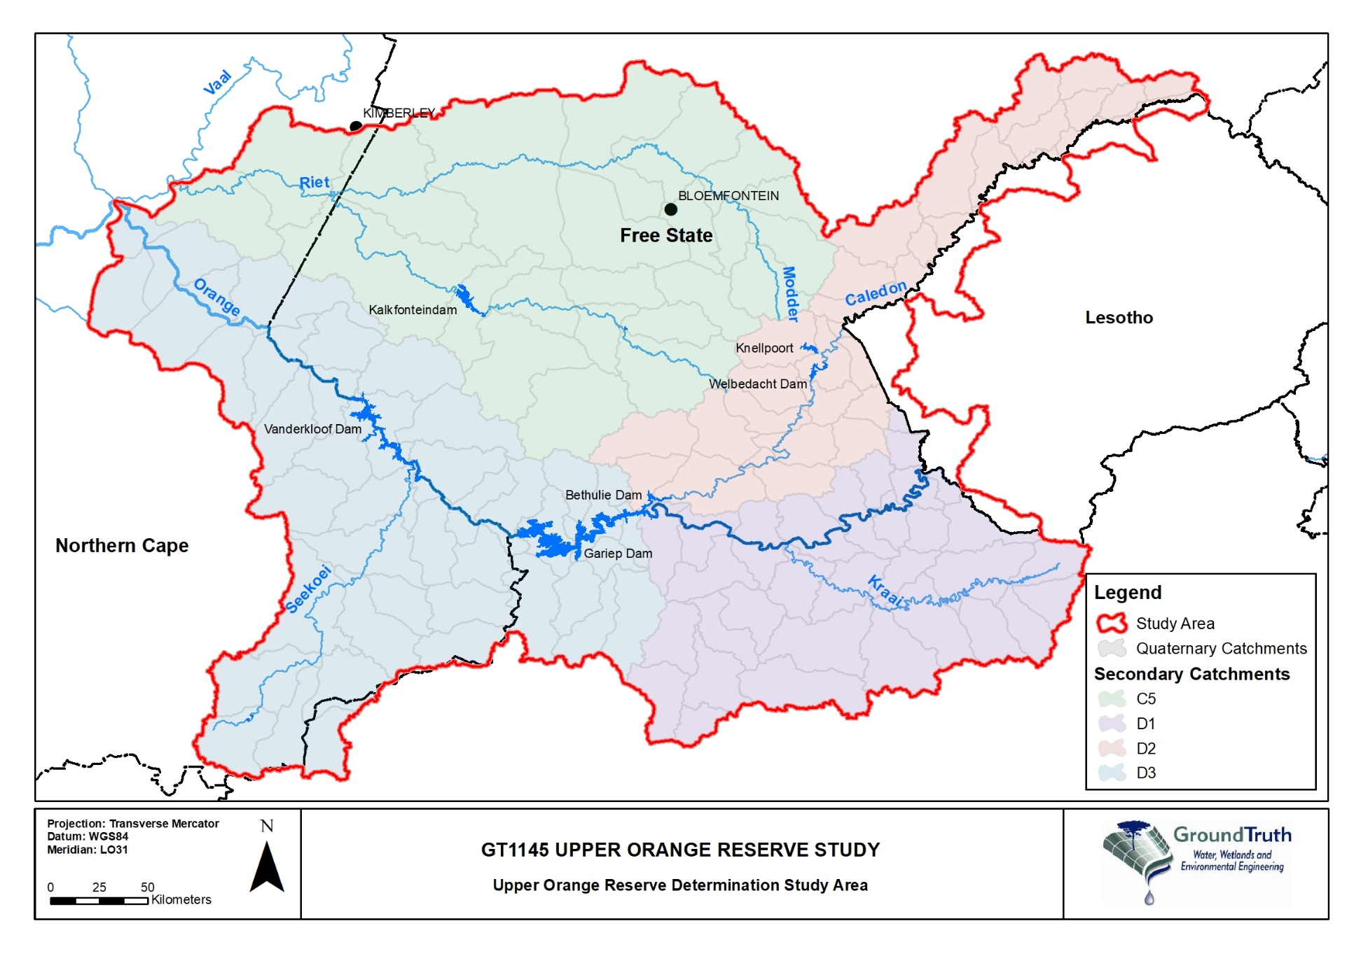
Study Area: Important Ecological/ protected areas
Several nature reserves and conservation areas
Golden Gate National Park
Tussen-2-Riviere Nature Reserve
Mokala National Park
Tifendell Ski Resort (upper reaches of the Kraai River): border of Lesotho

Slide 6
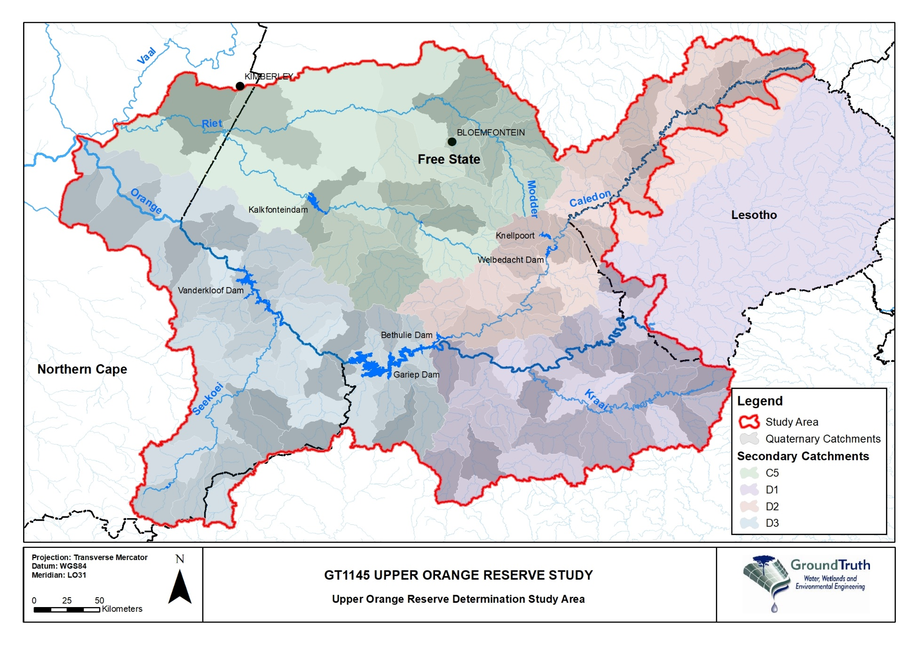
Study Area: Dams and major transfers
Modder River:
Rustfontein Dam
Mockes Dam
Krugersdrift Dam
Riet River:
Tierpoort Dam
Kalkfontein Dam
Caledon River:
Armenia Dam
Egmont Dam
Welbedacht Dam
Off-channel:
Knellpoort Dam
Orange:
Gariep
Vanderkloof
Great Fish River (EC)

Slide 7
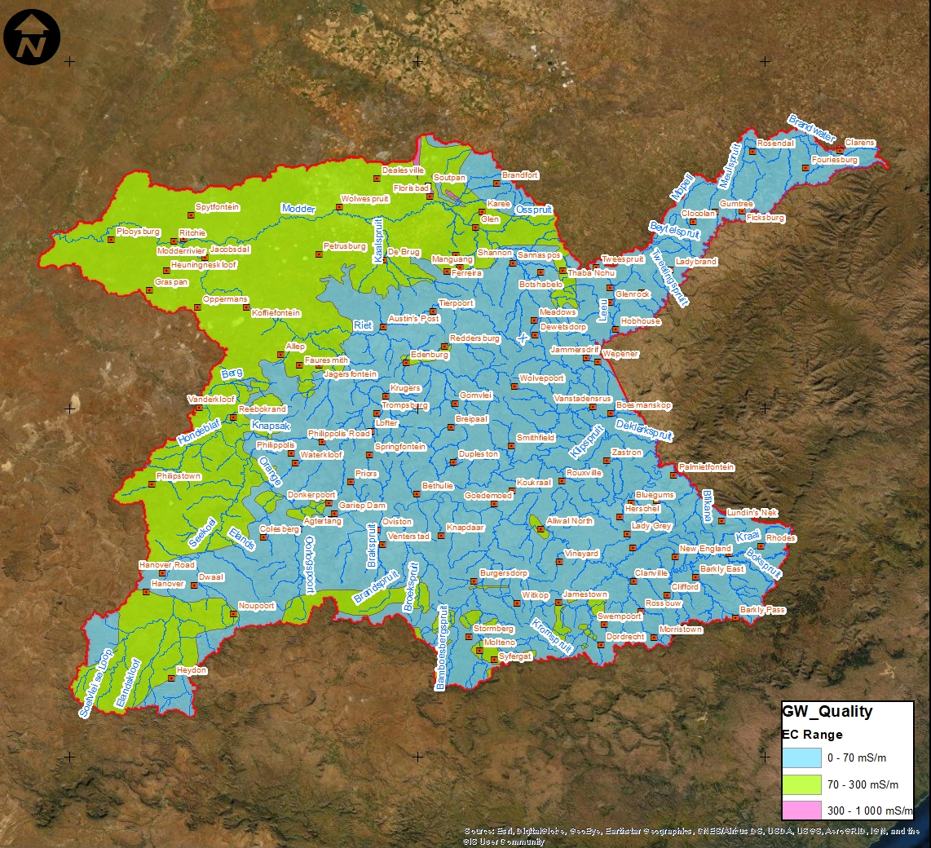
Study Area: Groundwater
  The major transboundary aquifer, i.e. The Karoo Sedimentary Aquifer
    Aquifer types associated with the Karoo Supergroup include “fractured” (brittle nature of the rocks in response to deformation processes) and “fractured and intergranular” (represented by dolerite sills and dykes).
GW quality
  Varies over the catchment area
  Electrical conductivity was used as the overall GW quality indicator
  Mainly good: eastern parts of the catchment (0 – 70 mS/m)
  Deteriorates: towards the western parts (70 – 300 mS/m)

Slide 8
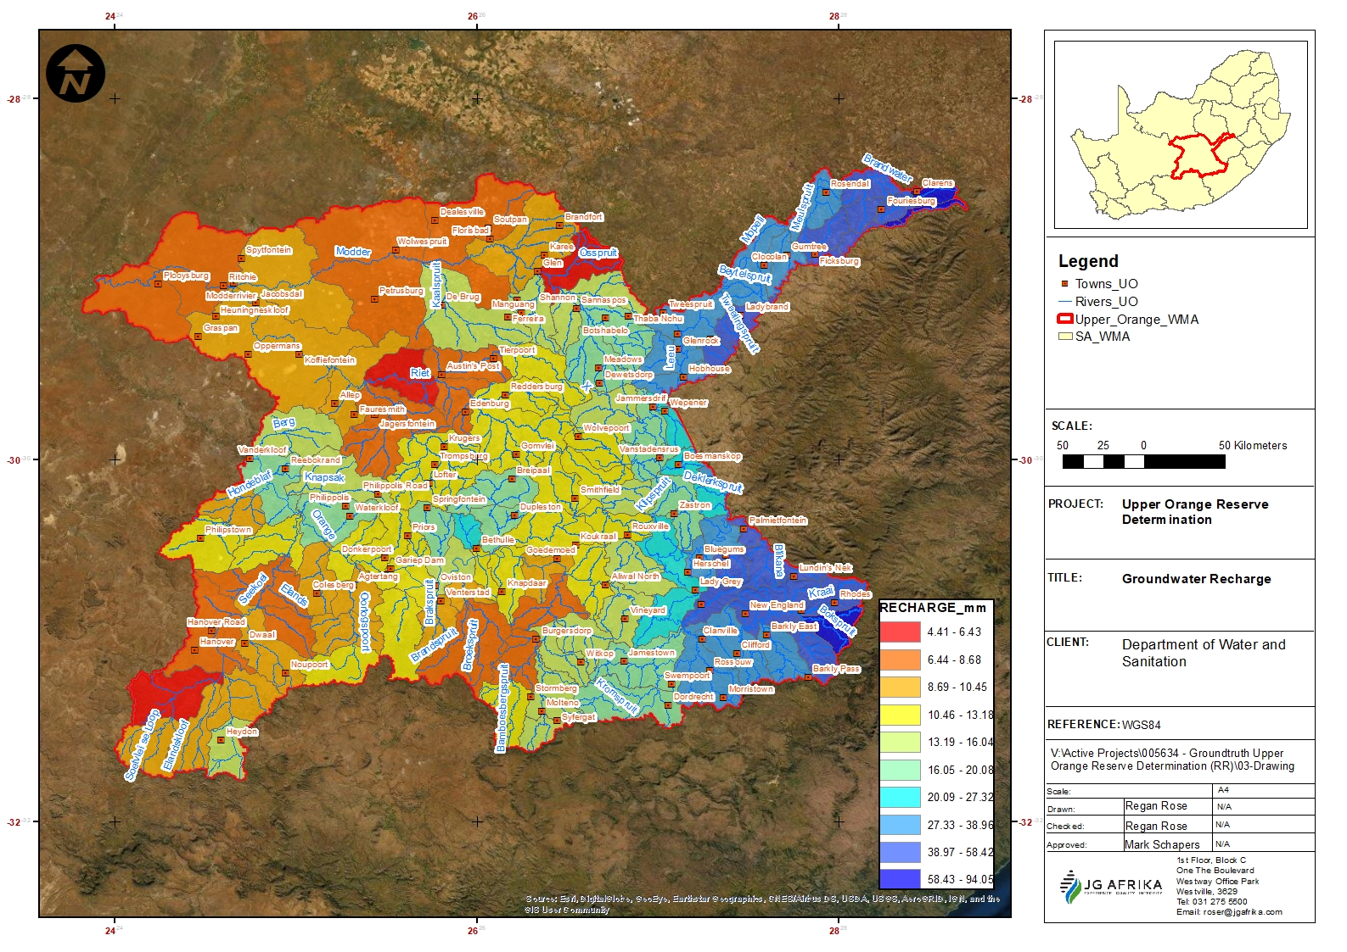
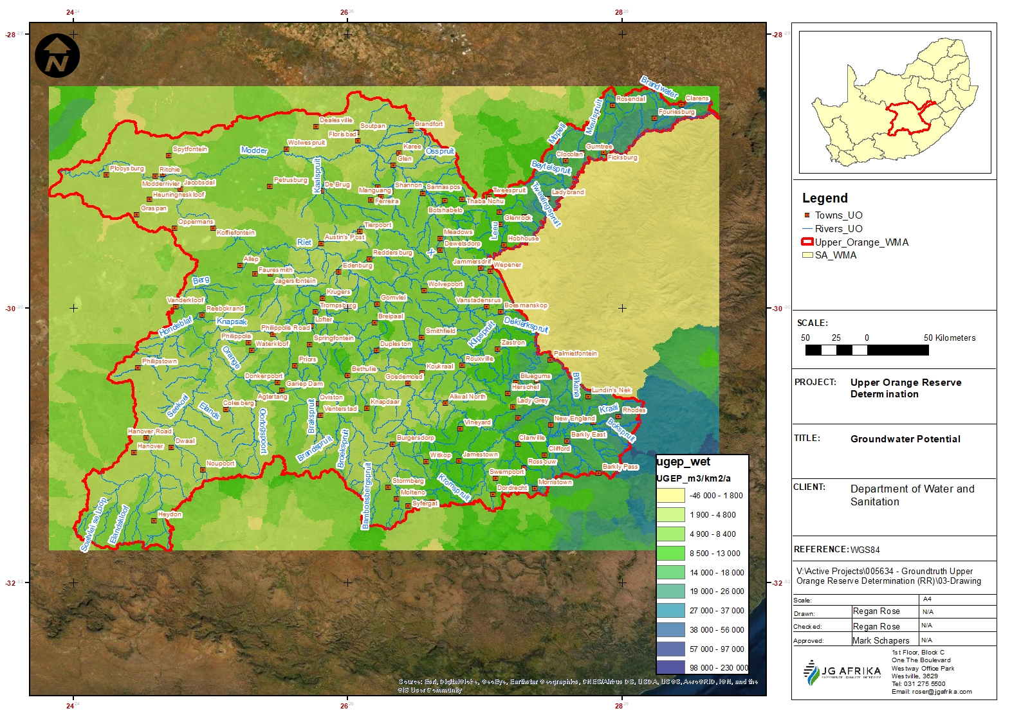
Study Area: Groundwater
GW recharge
  Similar spatial distribution is observed with GW recharge
  Highest along the Lesotho Highlands areas: max 4mm/annum)
  Lowest to the west and southwest: min 4mm/annum.
  Utilisable Groundwater Exploitation Potential (UGEP): sustainable potential yield that may be used for planning purposed
  Varies: ~26 000m³/km²/a (east) to
  ~1 900m³/km²/a (west)
GW potential

Slide 9
Study Area: Wetlands
  Most common wetland type through the catchment is largely depression wetlands located in:
      Northern and north-eastern areas of the Free State
      Western portions of the Northern Cape
      Upper reaches of the Eastern Cape
  Categorised primarily as Least Concern followed by Vulnerable based on:
    Vulnerability of the wetland type
    Vegetation with more than half of the identified wetlands in a largely natural state with limited modifications.
  Main modifications on the wetlands include multiple land use impacts i.e. irrigated commercial croplands, mining operations, populated areas and poor land use management practices (over-grazing)

Slide 10
Study Area: Main Impacts
The Caledon System:
Localised nutrient enrichment (WWTW)
Return flows from irrigation
Large sediment loads.(mainly from Lesotho)
Transfer to Modder River
The Modder-Riet System:
High nutrient enrichment (WWTW)
Irrigation and return flows having a high impact
Transfers from Caledon (through Knellpoort Dam), Van der Kloof Dam to Riet (via canal system) and from Marksdrift to lower Modder-Riet
The Middle Orange System:
Changed flow patterns due to releases for downstream irrigation
Localised nutrient enrichment (WWTW)
Return flows from the irrigation
Algal blooms in the main stem
Large sediment loads: alluvial diamond mining/prospecting.
The Upper Orange System:
Reduced flows due to dams and water transfers from Lesotho
Return flows from the irrigation on main stem
Algal blooms: Gariep Dam
Large sediment loads: erosion due to over grazing from SA and Lesotho
Transfer from Gariep to Fish River (Eastern Cape)
Flow fluctuation below Gariep and Van Der Kloof Dams due to hydropower releases
The Kraai System:
Water quality of the resources still in a relatively good state
Localised nutrient enrichment (irrigation)
Some return flows but minimal

Slide 11
Study Objective
  Identify the gaps to be addressed in the Upper Orange catchment.
  To determine the Reserve (quantity/quality of the EWR and BHN for the rivers at various EWR sites).
  Determine the water quantity/quality component of the EWR and BHN for the priority wetlands/wetland clusters where applicable.
  Determine the groundwater quality/quantity component of the BHN and the groundwater quantity component of the EWR for each resource unit/ quaternary catchment in the study area.
  Assess and evaluate operational scenarios, considering water transfers and developments in Lesotho and estuarine requirements in Lower Orange River.
  Determine ecological specifications/protection measures to support the Reserve requirements.
  Prepare the EWR and BHN templates for the Upper Orange Reserve.

Slide 12
Approach
  Study is of a technical nature, supported by stakeholder engagement.
  The approach and methodology that are followed for this study is in accordance with the 8-step process as outlined in Regulation 810 (Government Gazette 33541) dated 17 September 2010
  Reserve determination process as specified in the ‘Development of Procedures to operationalise Resource Directed Measures (DWS, 2017).
  Methodologies for Reserve determinations of rivers, wetlands and groundwater

Slide 13
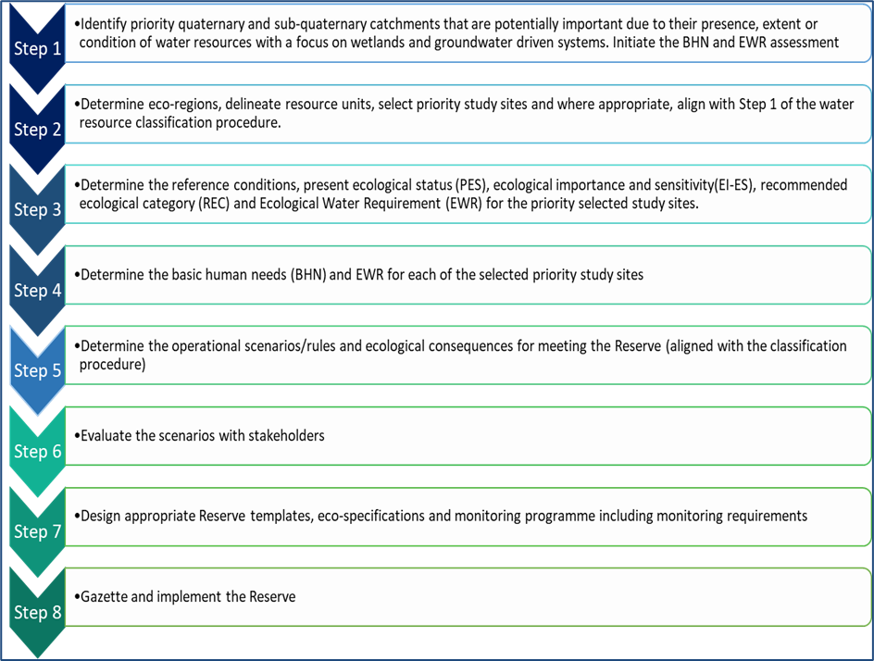
Approach, DWS 2017

Slide 14
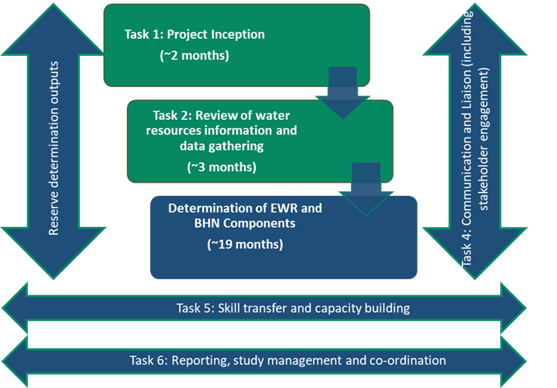
Main tasks
Completed
Currently

Slide 15
Task 1: Project Inception Completed
Critical component of the project
Understanding the nature of the Scope of Work and alignment with DWS expectations
Confirmation of study area, study team and approaches
Task 2: Data review, gaps analysis, RUs Completed
Review of water resource information, models and data gathering
Describe impacts, identify hotspots/ stressed areas and gaps
Identify priority Resource Units for all water resource components

Slide 16
Information Review: Rivers
  Main studies:
  DWA, 2009. Development of an Integrated Water Quality Management Strategy for the Upper and Lower Orange River Water Management Areas
  ORASECOM, 2010. Basin-wide Integrated Water Resources Management Plan: Environmental Flow Requirements
  ORASECOM, 2010, 2015 and 2021. Joint Basin Surveys – aquatic ecosystem health reports
  WRC, 2010. Developing a method for determining the environmental water requirements for non-perennial systems (focus area – Seekoei River catchment)
  DWS, 2014. Development of Reconciliation Strategies for Large Bulk Water Supply Systems
  DWS, 2014. PES – EI/ES
  ORASECOM, 2014. National Action Plan for the Basin
  ORASECOM, 2014. Environmental flow requirements of Basin

Slide 17
Rivers: Previous Reserve studies
Study | Reserve sites
ORASECOM 2010: Intermediate EFR study | 1 site on the Kraai River 2 sites on the Caledon River 1 site on the Orange River (Hopetown)
Pre-2010. Rapid 3 studies | 4 EWR sites along the Modder/ Riet system Sites on upper Caledon and main tributaries
2006 – 2010: High confidence study | 4 sites on the Seekoei River
Vaal Comprehensive Reserve Study (2006 – 2010) | A comprehensive site - lower reaches of the Riet River
Ad hoc rapid level 3 studies | Tributaries of the Karringmelkspruit and Wilgespruit in D12E and D13K Main stem Caledon River in D22D
  Above info/in-field surveys undertaken will provide high confidence ecological input for the management of this highly regulated system
Notes:
Several Reserve studies: different levels of detail (not for entire catchment)

Slide 18
Information Review: Wetlands
  Existing information on the general extent and distribution of wetlands
  Google Earth
  Available data and information on wetland types/features from NFEPA / NWM5
  Some information gathered from the PES/EIS (DWS, 2014)
  Previous specialist studies
  Local knowledge

Slide 19
Information Review: Groundwater
  Focus on available data and information from WR2012
  Available reports:
  Overview of water resources – Availability and Utilisation
  Internal Strategic perspective
  All Towns Reconciliation Strategies
  Additional specialist studies and local knowledge will be required:
    Identify certain “hot spot” areas
    Where the groundwater potential is low and the demand is high

Slide 20
Key gap identification: Rivers
Criteria | Key gap | Interventions
Hydrology
Gauged daily data | Limited gauging stations in catchment area. Old/unreliable/poor quality of flow data. Dam balances but unreliable due to environmental factors namely rainfall/evaporation. | Monitoring of long-term flow data falls outside the scope of this study. Will use where available and indicate confidence in results.
Water quality
Current water quality data | Indications are that much of this monitoring stopped in early 2018. | Information from other sources (JBS3 – Upper Orange catchment) will be utilised to assess the current state of water quality in the study area.

Slide 21
Key gap identification: Wetlands
Criteria |  | Key gap |  | Interventions
Wetlands
Wetland identification | Gaps in the national wetland coverage for the middle to southern reaches of the Free State. Upper reaches of Kraai (SWSA) | Gaps in the national wetland coverage for the middle to southern reaches of the Free State. Upper reaches of Kraai (Strategic Water Source Area) | Combine all existing and relevant wetland shapefiles into a consolidated and updated wetland shapefile. Specialist wetland workshops (2) have been held with SANBI, DWS, Northern Cape Wetland Forum, Working for Wetlands representatives and various other wetland specialists for input/support to address these gaps. Focused areas to be identified to ensure the cross-linkage between wetland, groundwater and rivers. | Combine all existing and relevant wetland shapefiles into a consolidated and updated wetland shapefile. Specialist wetland workshop being held with SANBI, DWS, Northern Cape Wetland Forum, Working for Wetlands representatives and various other wetland specialists on 9 December 2021 for further input/support to address these gaps. Focused areas to be identified to ensure the cross-linkage between wetland, groundwater and rivers.

Slide 22
Key gap identification: Groundwater
Criteria | Key gap |  | Interventions
Groundwater
Groundwater information | Local databases (WARMS, etc.) and reports | Propose a technical task group meeting with DWS and key Project Steering Committee/ Water User Association members Collect new data in focused areas i.e. priority quaternary catchments where linkages occur between groundwater, wetlands and rivers. | Propose a technical task group meeting with DWS and key Project Steering Committee/ Water User Association members Collect new data in focused areas i.e. priority quaternary catchments where linkages occur between groundwater, wetlands and rivers.
Integration
Integration between components | No existing information or processed data available for the integration of the various components. Some partial integration between components has been undertaken as part of previous Reserve studies | A specific area will be selected where the integration of rivers, wetlands and groundwater components will be undertaken. It is proposed that the Kraai River catchment is used as it also forms part of the SWSA | A specific area will be selected where the integration of rivers, wetlands and groundwater components will be undertaken. It is proposed that the Kraai River catchment is used as it also forms part of the SWSA

Slide 23
Resource Units
  Linear stretches of rivers which require different EWRs (due to different flow patterns, reaction of habitat and biota to stress, management and operational structures)
  RUs can also be delineated as primary wetland areas / major dams / important groundwater systems
  Considering a variety of factors, namely ecoregions, geomorphologic classification, water quality, land use, habitat integrity, physical system constraints, HGM types for wetlands, groundwater hotspots, local knowledge etc.
Socio-Cultural Importance
Ecological considerations
Priority Resource Unit
Water use impacts/ considerations

Slide 24
Resource Units: Delineation and Prioritisation
Prioritise SQs with:
High priority – level 1 RU
Moderate priority – level 2 RU
Low priority – level 3 RU
SW resources
Rate use importance
Prioritize SW SQs
Consider planned developments
GW resources
Delineate study area = GW RUs
Prioritize RUs by SFR, stress-index, water level and quality
Key drivers
Finalise level of assessment (desktop, field verification, rapid 3, intermediate/ comprehensive)
RU delineation and site selection
(rivers)
Water quality
Prioritize water quality problem areas
Identify pollution/priority protection areas
Rivers (each SQ)
Determine the EIES, SWSA
Consider fish sanctuaries, IUCN listed species
Sensitive macroinvertebrates
Protected riparian vegetation/ invasive plants
Prioritize SQ
Information and data collection
Select EWR sites
Aquatic Ecosystems
Prioritized River SQs, wetlands, groundwater RUs
Wetlands
Identify spatial distribution/extent of wetlands, types, PES, EIS of wetland RUs
Identify wetland priorities based on ecological status
Ecosystems Services and Value
High level assessment of ecosystem services and values
Notes:
Estuary function zone

Slide 25
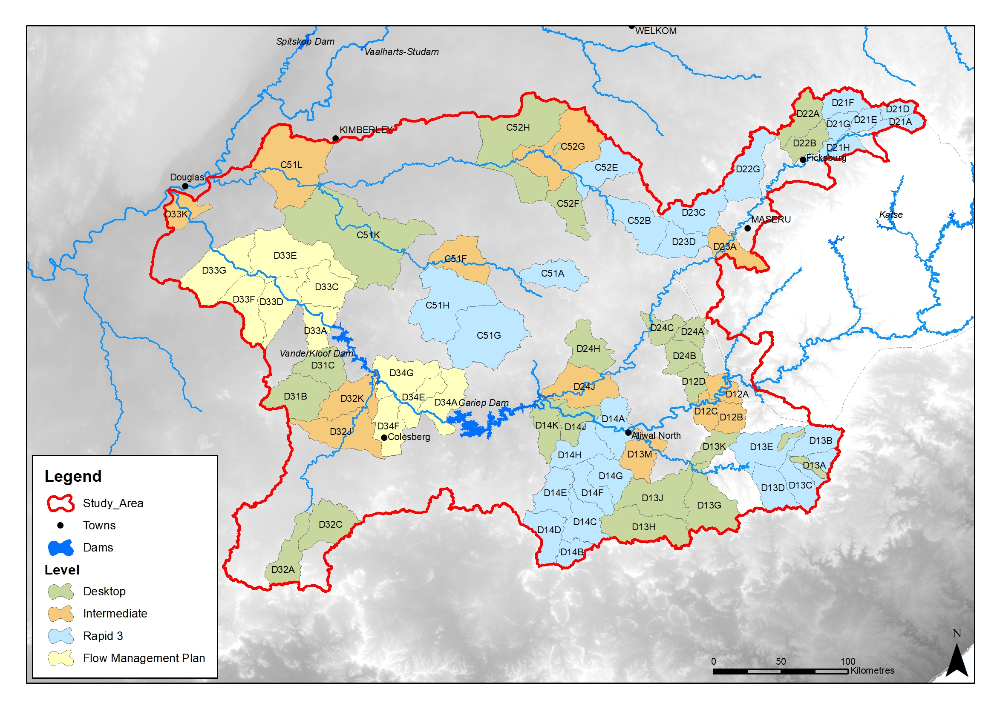
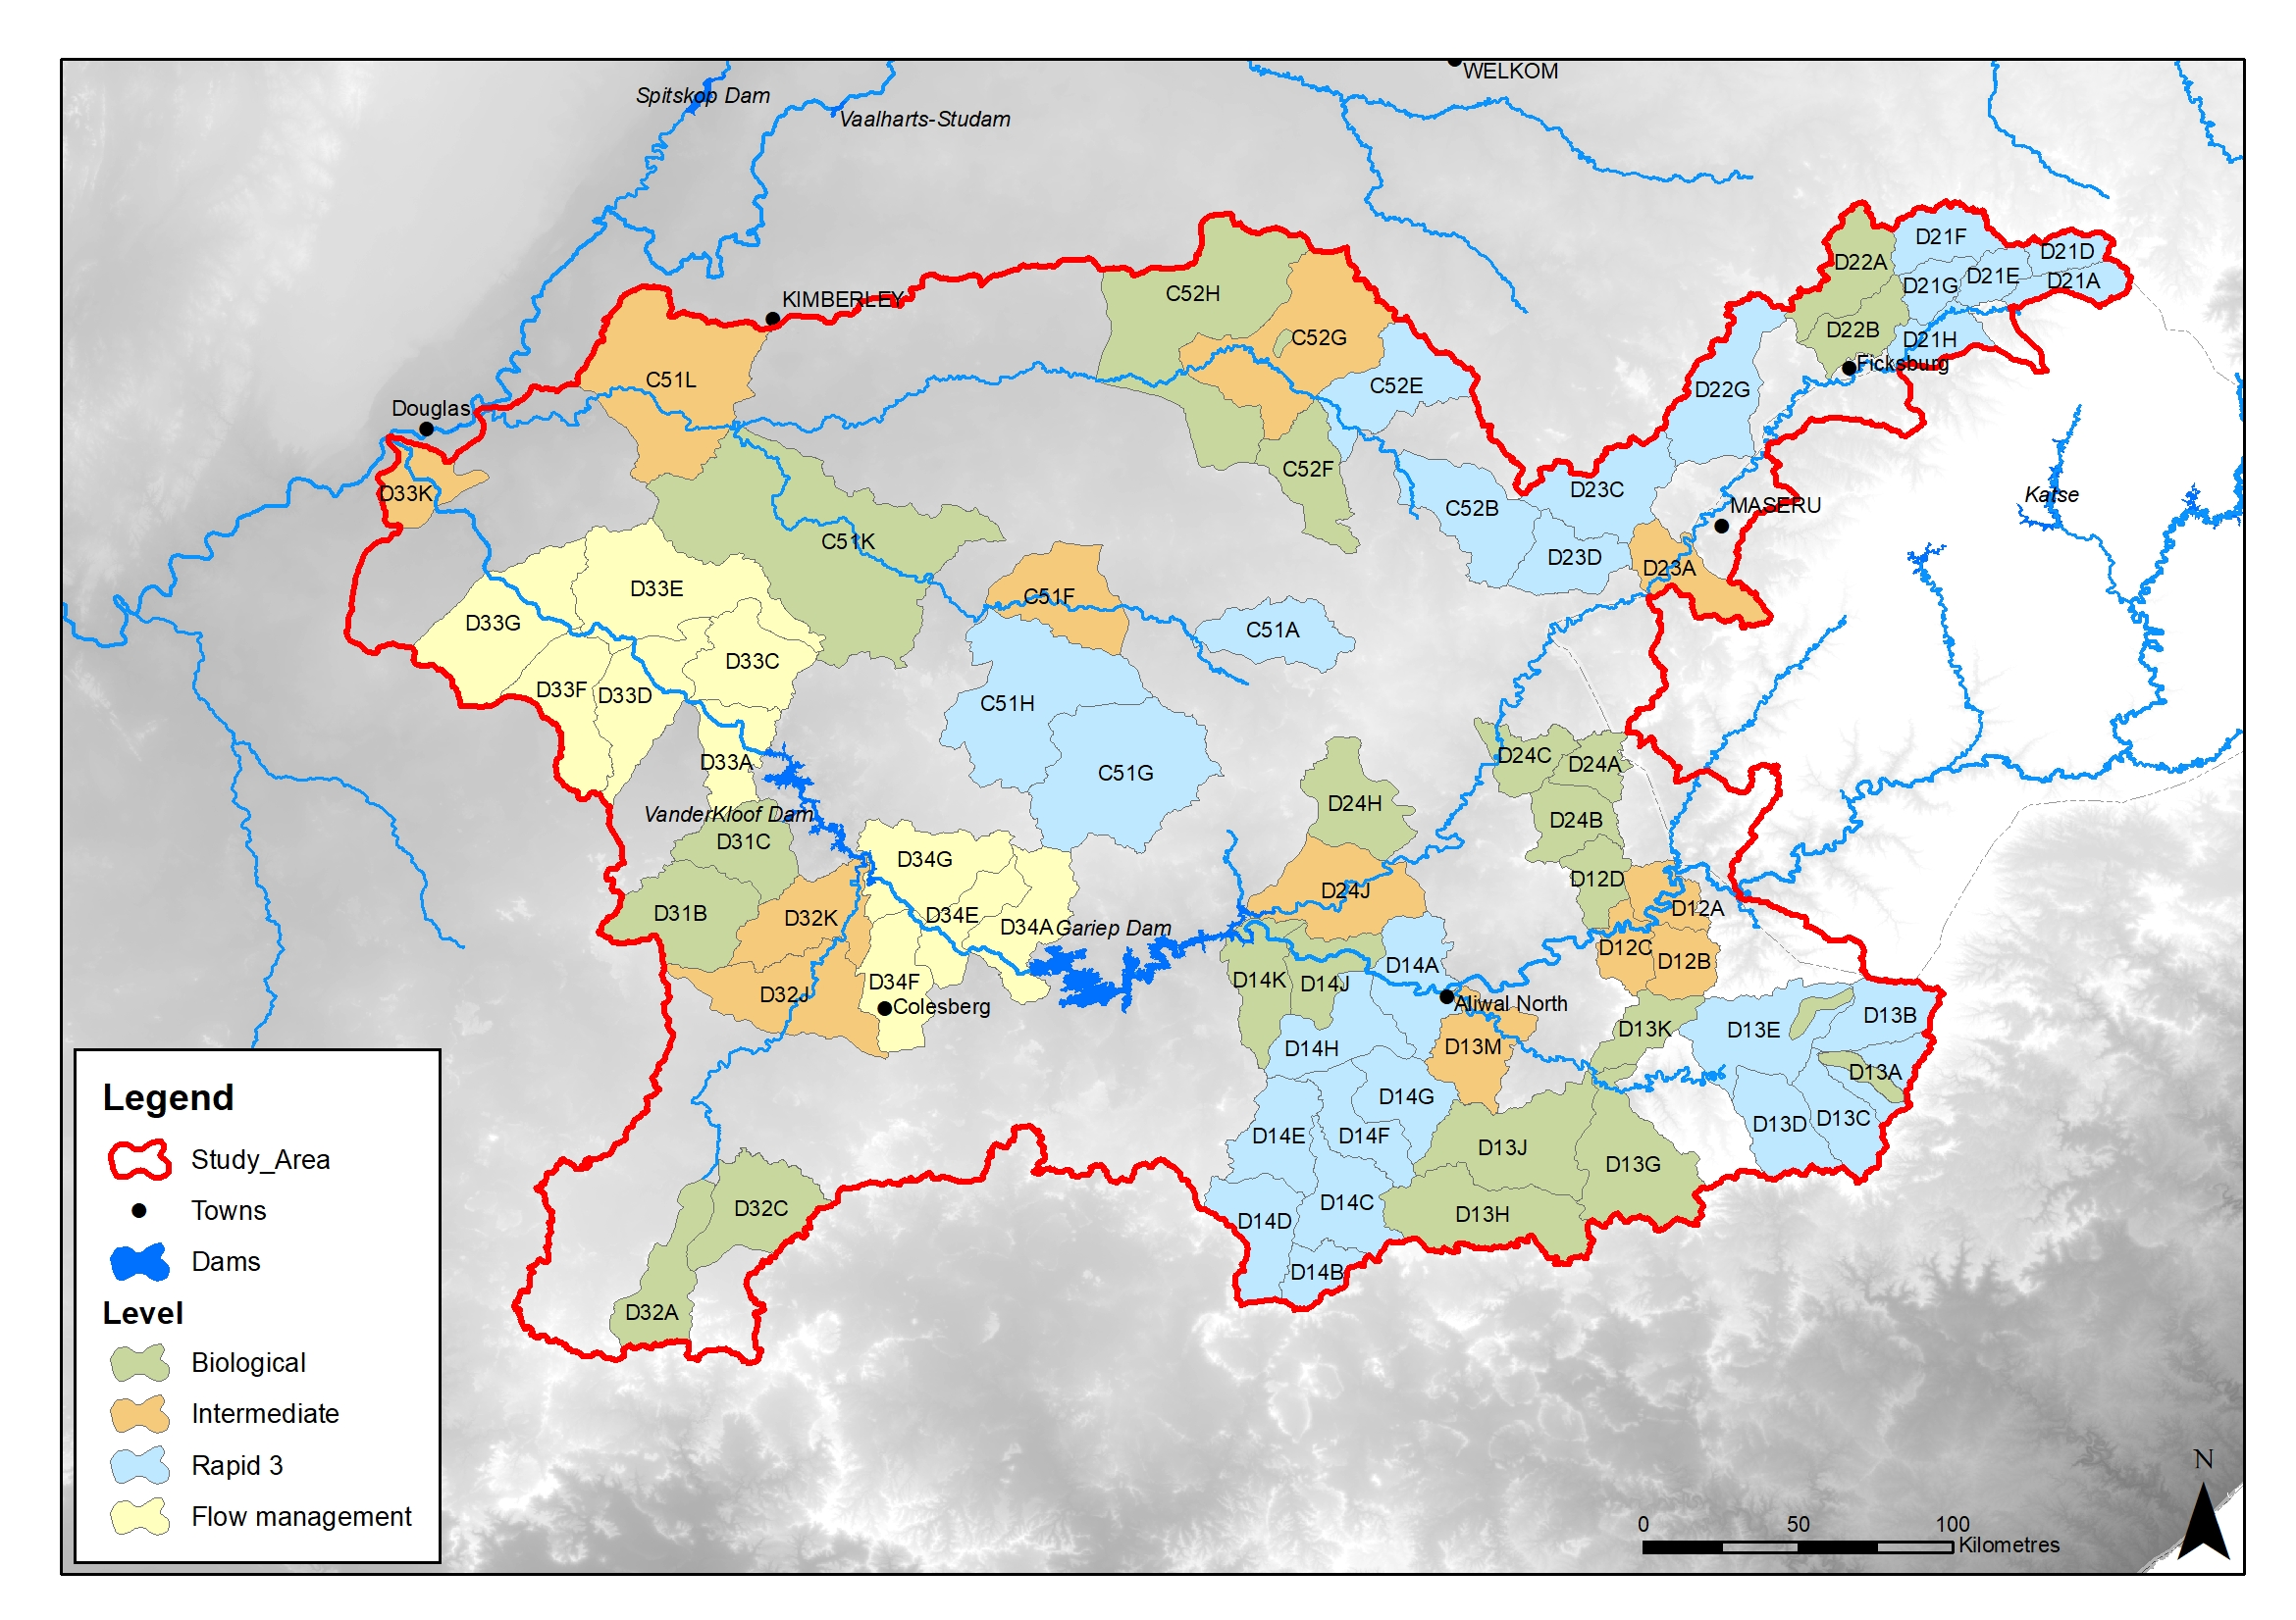
Results: Prioritization River RUs: Intermediate
River | Quaternaries
Middle Caledon | D23A
Lower Caledon | D24J
Upper Orange | D12A or D12C
Sterkspruit | D12B
Kraai | D13M
Seekoei | D32J or D32K
Lower Orange | D33K
Lower Riet | C51L
Upper Riet | C51F
Modder | C52G
Notes:
ranking of the priorities is from 1 (highest ranking) to 3 (lowest ranking).

Slide 26
River | Quaternaries
Little Caledon | D21D
Brandwater | D21G
Mopeli | D22G
Upper Kraai | D13B
Wonderboomspruit | D14E
Kromellenboog | C51H
Fouriespruit | C51A
Osspruit | C52E
Little Modder | C52B
Modder | C52B
Results: Prioritization River RUs: Rapid 3
River | Quaternaries
Little Caledon | D21D
Brandwater | D21G
Mopeli | D22G
Upper Kraai | D13B
Wonderboomspruit | D14E
Kromellenboog | C51H
Fouriespruit | C51A
Osspruit | C52E
Little Modder | C52B
Modder | C52B
Notes:
ranking of the priorities is from 1 (highest ranking) to 3 (lowest ranking).

Slide 27
River | Quaternaries
Meulspruit | D22A-B
Rantsho | D22D
Witspruit | D24A-C
Gryskopspruit | D12D
Maghaleng | D15H
Tele | D18K
Karringmelkspruit | D13K
Langkloofspruit | D13D
Bokspruit | D13A
Joggemspruit | D13E
Wasbankspruit | D13G
Holspruit | D13H-J
Klipspruit | D13M
Stormbergspruit | D14H
Orange | D14J-K
Skulpspruit | D24H
Elandskloof | D32A
Klein-Seekoei | D32C
Hondeblaf | D31B-C
Middle Riet | C51K
Upper Riet | C51F
Upper Kromellenboog | C51G
Tributary of Vanzylspruit | C51G
Rietspruit | C52G
Modder | C52K
Renoster | C52F
Upper Os-spruit | C52E
Results: Prioritization River RUs: Field verification
River | Quaternaries
Meulspruit | D22A-B
Rantsho | D22D
Witspruit | D24A-C
Gryskopspruit | D12D
Maghaleng | D15H
Tele | D18K
Karringmelkspruit | D13K
Langkloofspruit | D13D
Bokspruit | D13A
Joggemspruit | D13E
Wasbankspruit | D13G
Holspruit | D13H-J
Klipspruit | D13M
Stormbergspruit | D14H
Orange | D14J-K
Skulpspruit | D24H
Elandskloof | D32A
Klein-Seekoei | D32C
Hondeblaf | D31B-C
Middle Riet | C51K
Upper Riet | C51F
Upper Kromellenboog | C51G
Tributary of Vanzylspruit | C51G
Rietspruit | C52G
Modder | C52K
Renoster | C52F
Upper Os-spruit | C52E
Notes:
ranking of the priorities is from 1 (highest ranking) to 3 (lowest ranking).

Slide 28
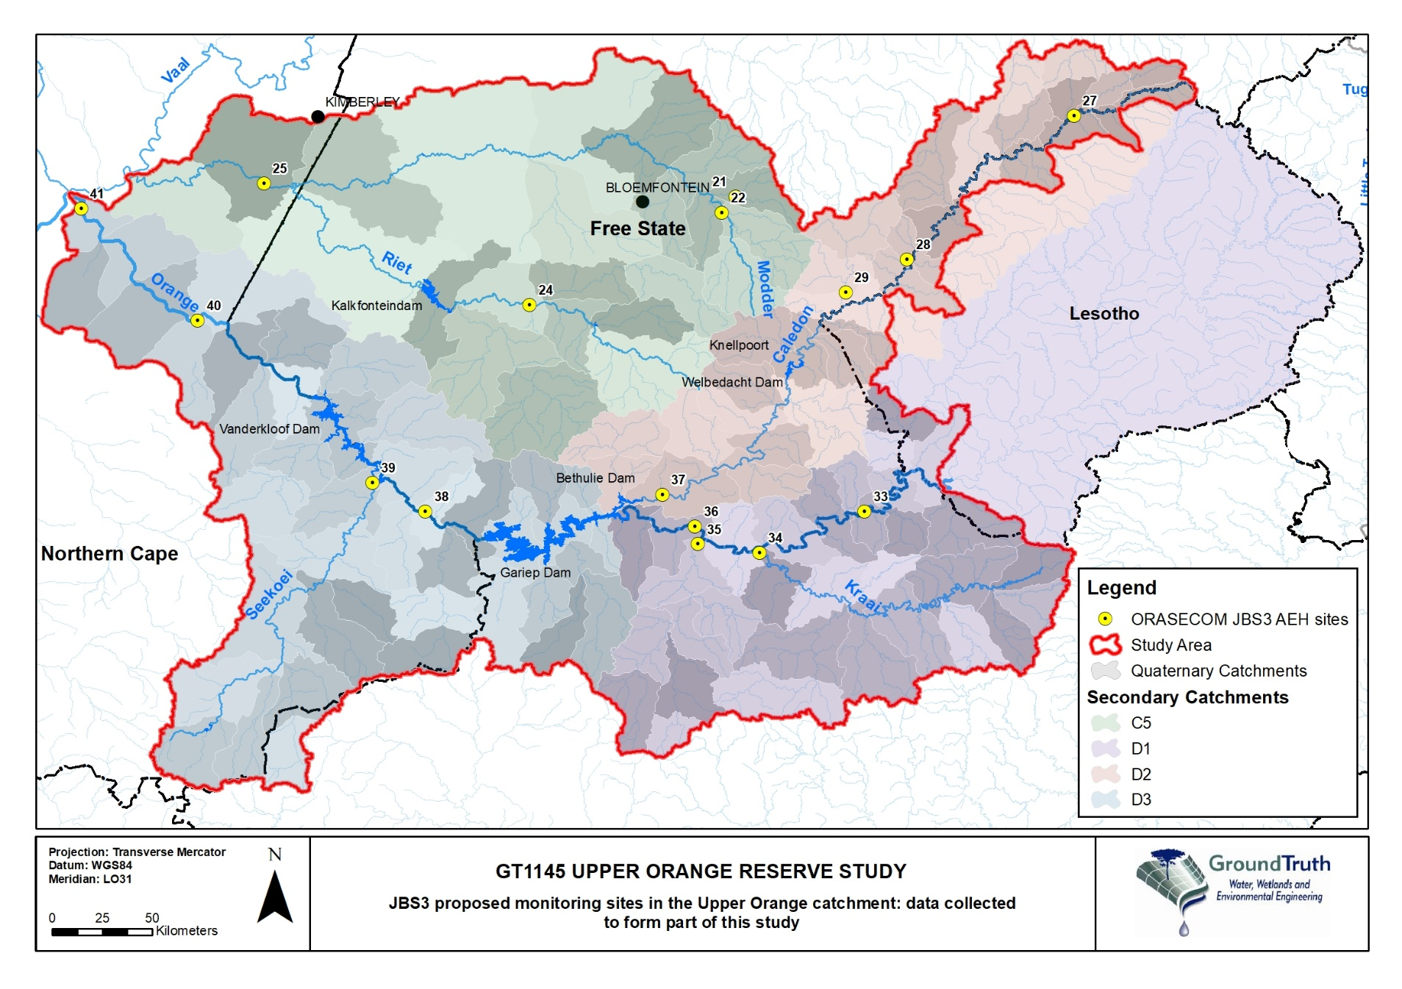
Prioritization River RUs: Conceptual Flow Management Plan
Reaches directly downstream of Gariep and Vanderkloof (hydropower and other releases)
Impacts:
  Disruption of longitudinal sediment transport
  Disruption in geomorphic effective flows
  Impact on habitat – armoured beds – narrow active channel
  Highly altered and modified system:
  Conceptual flow management plan
Notes:
ranking of the priorities is from 1 (highest ranking) to 3 (lowest ranking).

Slide 29
Delineating and prioritization for Wetlands RUs
Process:
Multi-criteria analysis undertaken
Wetland RU prioritisation based on key attributes
    (NWM5 spatial dataset, National Freshwater Ecosystem Priority Areas wetland shapefile, Crane sightings and other Important Bird Areas, interaction with the surface and groundwater SWSAs, Wetlands with a PES of A/B, Hydrogeomorphic Unit type and ability to supply ecoservices, Systems categorized as Critically Endangered/Endangered, Wetlands located upstream of important water supply dams, Identified water-stressed catchments/ basins from the river RU process, Located in water stress in terms of quantity and quality)
Presence (1) / absence (0) scoring system with-
    Wetlands systems associated with the key attributes: 1
    Wetland not associated: 0
The wetlands were then ranked accordingly from highest scores being the more important systems

Slide 30
Delineating and prioritization for Wetlands RUs
Using the data derived from the Multi-criteria analysis, a further review of the entire study area undertaken, and final RUs based on:
    Presence of SW and/or GW SWSAs
    Preliminary priority River RU quaternary catchments
    The top 10% of quaternary catchments identified through the WfWets strategic planning (EC, NC and FS provinces)
    Specific important wetland areas identified by individual stakeholders
    Quaternary catchments identified with the highest recorded water uses (water quantity)

Slide 31
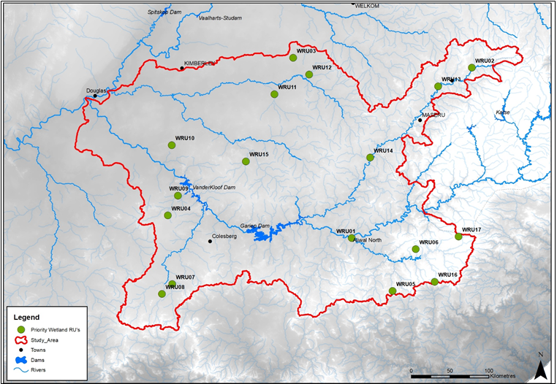
Results: Prioritization Wetland RUs

Slide 32
Results: Wetland Surveys
Site name | River | Description
WRU02 (D21G) | Brandwater | A large floodplain wetland associated with the Brandwater River, approximately 260ha in size and is located to the south of the R26 road between Fouriesburg and Ficksburg.
WRU03 (C52H) | No rivers | A large depression wetland complex consisting of a total of 27 depression wetlands that range in size from 6ha to 1 800ha. The largest of these wetlands is known as Soutpan and is an active salt mine as the name suggests.
WRU04 (D31B) | Tributary of Hondeblaf | A complex of two different wetlands, a depression wetland approximately 1 100ha in size and an unchannelled valley-bottom wetland approximately 190ha in size.
WRU05 (D13G) | Wolvespruit | A large wetland complex consisting of a series of unchannelled valley-bottom wetlands which are fed by multiple hillslope seep wetlands. In total, the WRU covers an area of approximately 340ha. A large number of Blue and Crowned Cranes were noted in the wetland.
WRU09 (D31C) | Hondeblaf | A predominantly fluvial system that has wetland indicators which have formed in the flood back of a dam along the Hondeblaf River. Excluded due to artificial nature and is significantly smaller than initially expected based on the desktop assessment of the system.
WRU10 (D33C) | Lemoenspruit | A large series of depression wetlands that are hydrologically connected both via surface and groundwater. These depression wetlands range in size from 7ha to 1 200ha. These fluvially connected wetlands appear to flow in a south-easterly direction into the Lemoenspruit River which is a tributary of the Orange River.
WRU11 (C52J) | Kaalspruit | A large wetland complex consisting of a number of depression wetlands, a discontinuously channelled valley-bottom and a channelled valley-bottom wetland. The mainstem valley-bottom wetland is approximately 2 800ha in size with the depression wetlands scattered alongside this valley-bottom wetland.
WRU12 (C52G) | Rietspruit | A large wetland complex that includes a large wetland flat and a discontinuously channelled valley-bottom wetland. The entire complex is approximately 1 700ha in size and has a very gentle gradient.
WRU13 (D22D) | Rantsho | A large wetland complex approximately 275ha in size and is similarly located between the R26 road and the Mohokare/ Caledon River and is located on the Rantsho River. The floodplain wetland has three distinct sections that are separated by a very confined section of valley.
WRU15 (C51H) | Prosesspruit | A large contiguous series of wetlands that originate from four different rivers and coalesce into a valley-bottom wetland. The wetland type can be considered to be a discontinuously channelled valley-bottom wetland as the channel is not consistent throughout the HGM unit. The entire wetland complex is approximately 1 900ha in size.
WRU16 (D13D) | Tributary of Lankloofspruit | A significant wetland complex consisting of multiple valley-bottom and hillslope seep wetlands which, in total, spread across an area of approximately 230ha. Forms an extremely important water source to the Kraai River.
WRU17 (B13B) | Tributary of Upper Kraai | A high-altitude wetland complex consisting of a series of hillslope seeps and valley-bottom wetlands which cover a total area of 190ha. These wetlands are characterised by very shallow soils and the predominance of Merxmuellera disticha.
River | Description
Brandwater | A large floodplain wetland associated with the Brandwater River, approximately 260ha in size and is located to the south of the R26 road between Fouriesburg and Ficksburg.
No rivers | A large depression wetland complex consisting of a total of 27 depression wetlands that range in size from 6ha to 1 800ha. The largest of these wetlands is known as Soutpan and is an active salt mine as the name suggests.
Tributary of Hondeblaf | A complex of two different wetlands, a depression wetland approximately 1 100ha in size and an unchannelled valley-bottom wetland approximately 190ha in size.
Wolvespruit | A large wetland complex consisting of a series of unchannelled valley-bottom wetlands which are fed by multiple hillslope seep wetlands. In total, the WRU covers an area of approximately 340ha. A large number of Blue and Crowned Cranes were noted in the wetland.
Hondeblaf | A predominantly fluvial system that has wetland indicators which have formed in the flood back of a dam along the Hondeblaf River. Excluded due to artificial nature and is significantly smaller than initially expected based on the desktop assessment of the system.
Lemoenspruit | A large series of depression wetlands that are hydrologically connected both via surface and groundwater. These depression wetlands range in size from 7ha to 1 200ha. These fluvially connected wetlands appear to flow in a south-easterly direction into the Lemoenspruit River which is a tributary of the Orange River.
Kaalspruit | A large wetland complex consisting of a number of depression wetlands, a discontinuously channelled valley-bottom and a channelled valley-bottom wetland. The mainstem valley-bottom wetland is approximately 2 800ha in size with the depression wetlands scattered alongside this valley-bottom wetland.
Rietspruit | A large wetland complex that includes a large wetland flat and a discontinuously channelled valley-bottom wetland. The entire complex is approximately 1 700ha in size and has a very gentle gradient.
Rantsho | A large wetland complex approximately 275ha in size and is similarly located between the R26 road and the Mohokare/ Caledon River and is located on the Rantsho River. The floodplain wetland has three distinct sections that are separated by a very confined section of valley.
Prosesspruit | A large contiguous series of wetlands that originate from four different rivers and coalesce into a valley-bottom wetland. The wetland type can be considered to be a discontinuously channelled valley-bottom wetland as the channel is not consistent throughout the HGM unit. The entire wetland complex is approximately 1 900ha in size.
Tributary of Lankloofspruit | A significant wetland complex consisting of multiple valley-bottom and hillslope seep wetlands which, in total, spread across an area of approximately 230ha. Forms an extremely important water source to the Kraai River.
Tributary of Upper Kraai | A high-altitude wetland complex consisting of a series of hillslope seeps and valley-bottom wetlands which cover a total area of 190ha. These wetlands are characterised by very shallow soils and the predominance of Merxmuellera disticha.

Slide 33
Delineating and prioritization for Groundwater RUs
Where water resources sufficiently different from one another and thus are delineated into distinct units that have similar properties, with delineation being based on geohydrological, management/other criteria
Can comprise part of a quaternary catchment, or a group of quaternary catchments
Primary Delineation
  Quaternary Catchment by definition (WR2012)
  GW Strategic Water Source Areas
Secondary Delineation
  Subsurface conditions play an important role in controlling geohydrological characteristics / conditions
  4 Main types of aquifers
  * Intergranular (primary), Fractured (secondary), Fractured & Intergranular
  and Karst (dolomitic)

Slide 34
Delineating and prioritization for Groundwater RUs
Tertiary Delineation
          Expert judgement, local knowledge & Conceptual Understanding
          Physical criteria include geology, climate, topography, recharge, gw levels & flow directions, temp hydrostatic response patterns, gw quality, gw use/stress, GW dependent ecosystems)
          Management criteria, including property, WUA, Catchment management, water management, political boundaries
          Functional criteria
          Role GW plays sustaining the environment
    Abstraction (WARMS)
      Hotspots identified
    Wetlands
      Major systems identified and overlayed
    Strategic Groundwater Resources

Slide 35
Results: Groundwater surveys
Quaternary Catchment/s | City / Town
C52G, C52J, C52F, C52D, C51H | Bloemfontein, Jagersfontein
C52H, C52G | Soutpan
C52K | Petrusburg
C52K, D33K, D33C | Dealesville, Ritchie, Jacobsdal, Luckhoff
D32A, D32B, D32E | Hanover, Noupoort
D13D, D13E, D18K, D13K, D13A, | Barkley East, Rhodes, Lady Grey

Slide 36
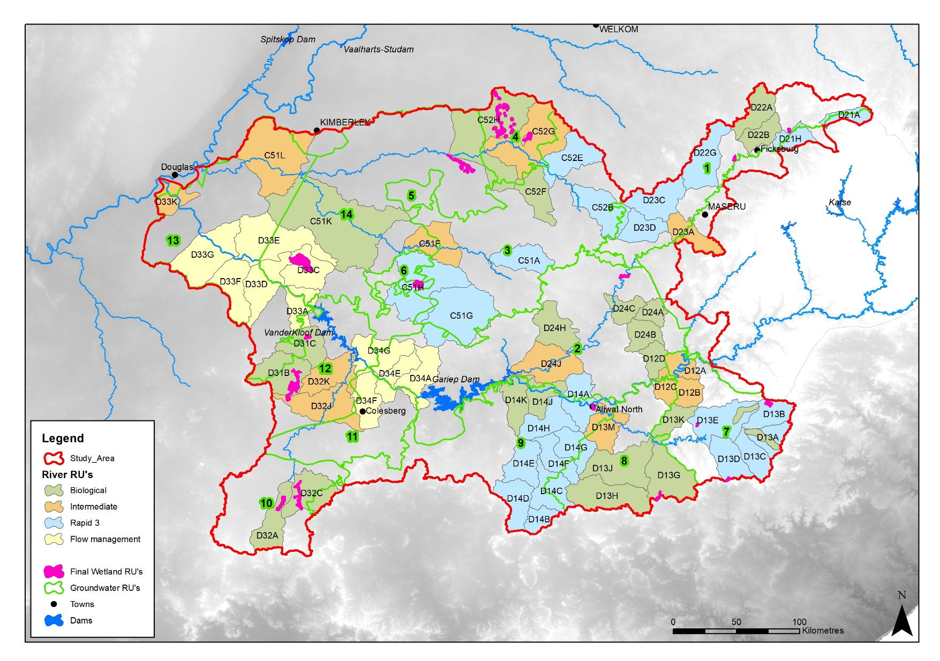
Results: Integration and Prioritization RUs
14 GRU delineated
Integration between wetlands and groundwater
Water quality issues due to irrigation
Integration between rivers and wetlands
Integration between rivers, wetlands and groundwater
SWSA (SW & GW)
Integration between wetlands and groundwater
Seasonal rivers

Slide 37
Stakeholder engagement
  Stakeholder engagement strategy
  Consolidated stakeholder database – working with DWS, JBS3 and RQO studies
  Background Information Documents
  Stakeholder public meeting – 31 March 2022
  Issues and response report

Slide 38
Capacity Building Programme
Capacity Building opportunity |  | Proposed month
1 | Approach for RU delineation and level of assessment | Aug-21
2 | Selection of priority wetland and groundwater RUs | Jan-22
3 | EWR site selection and river survey 1 (intermediate sites) | Mar-22
4 | Wetland surveys | Feb-22
5 | Groundwater surveys | Mar-22
6 | River survey 2 (rapid 3 and biological sites) | Jun-22
7 | Socio-economic outline and Socio-Cultural Importance (SCI) | Nov-21
8 | River Ecoclassification (EcoStatus models) | Jul-22
9 | River EWR quantification workshop (DRM, RDRM, HFSR) | Sep-22
10 | Groundwater workshop (PES, quantification and setting RQOs) | Aug-22
11 | Wetland's workshop (WET-Health, functioning, EIS) | Oct-22
12 | Stakeholder workshop 1 (Citizen Science) | Aug-22
13 | Scenarios and Water Resource Modelling | Nov-22
14 | Ecological consequences, ecospecs and monitoring | Jan-23
15 | Integration between components (rivers, wetlands & groundwater) | Feb-23
16 | Stakeholder workshop 2 (Citizen Science) | Jan-23
17 | 1-day Wrap-up training (all components) | Mar-23

Slide 39
Next steps of the study….
    In-field surveys:
      Rivers (dry season survey)
        4-15 July 2022
    Request from stakeholders for access to properties where survey sites are located during stakeholder meetings and follow-up communication
    Rivers Survey report
Notes:
ranking of the priorities is from 1 (highest ranking) to 3 (lowest ranking).

Slide 40
    Professional Service Provider:
    Stakeholder Engagement Specialist
    Ms Fonda Lewis
    0828038989
    Stakeholder.orange@groundtruth.co.za
    Project Director
    Dr Mark Graham
    0823777089
    mark@groundtruth.co.za
    Project Manager
    Mrs Kylie Farrell
    0836864212
    Kylie.farrell9@gmail.com
    Department of Water and Sanitation:
    Project Manager
    Ms Ndivhuwo Netshiendeulu
    0647596744
    NetshiendeuluN@dws.gov.za
    Scientific Manager
    Mr Kwazikwakhe Majola
    MajolaK@dws.gov.za
THANK-YOU
Notes:
ranking of the priorities is from 1 (highest ranking) to 3 (lowest ranking).

